Slide 1
Shrewsbury Raspberry Pi Meetup
Raspberry Pi Clusters
Brian Lingard
Sept. 26, 2017

Slide 2

What’s a cluster?
Generic cluster
Group of networked computers where each node works on the same task
HW is typically high performance or specially designed
Think “supercomputer”
i.e. thousands of nodes

Slide 3
Basic Cluster Architecture
Storage Array
Host Node
Compute
Node 1
Compute
Node 2
Compute
Node 3
Compute
Node N
Internet
. . .
High Speed Network Switch

Slide 4
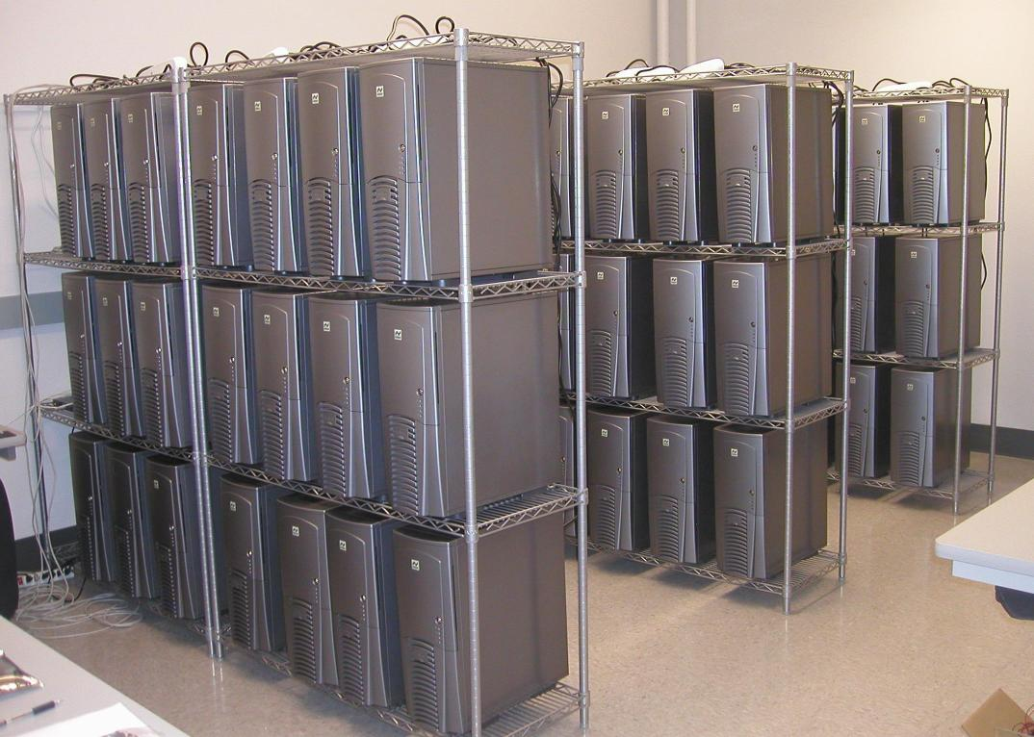
What’s a cluster?
Beowulf cluster
Name came from project built in 1994 by a pair of NASA engineers
Group of commodity-grade computers connected in a network
Repurposed older/low-end computers
And now Raspberry Pi’s

Slide 5
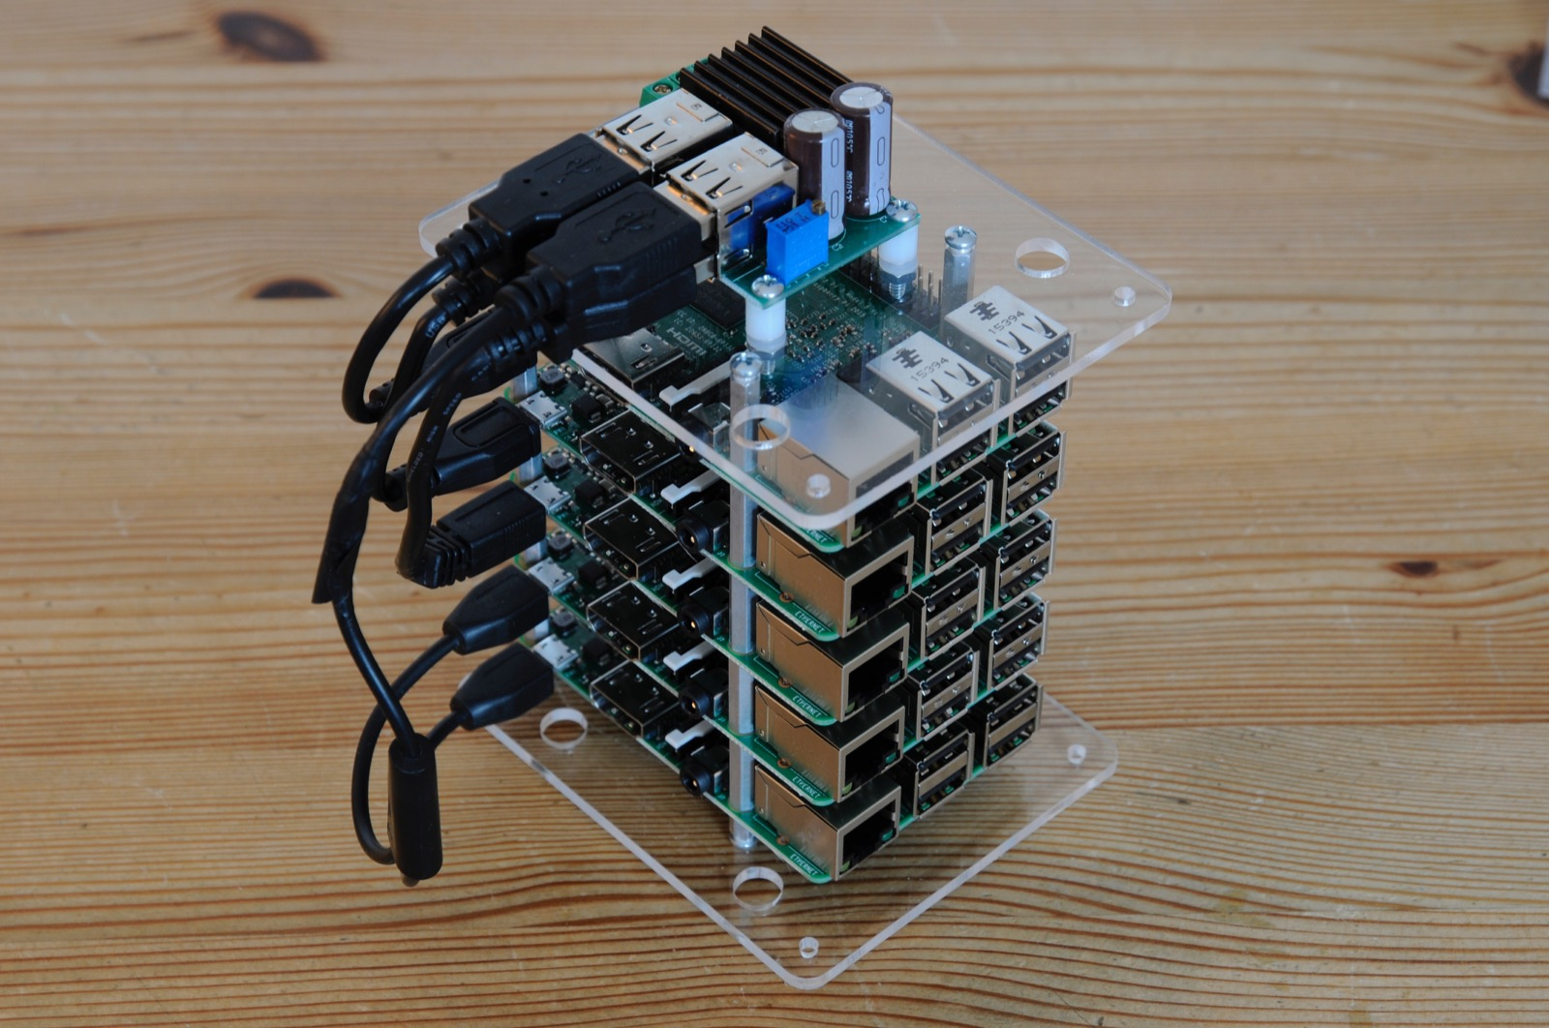
Raspberry Pi Clusters
Simple, home built
Usually 4 or 5 nodes
USB for power
Ethernet for comms
Via switch

Slide 6
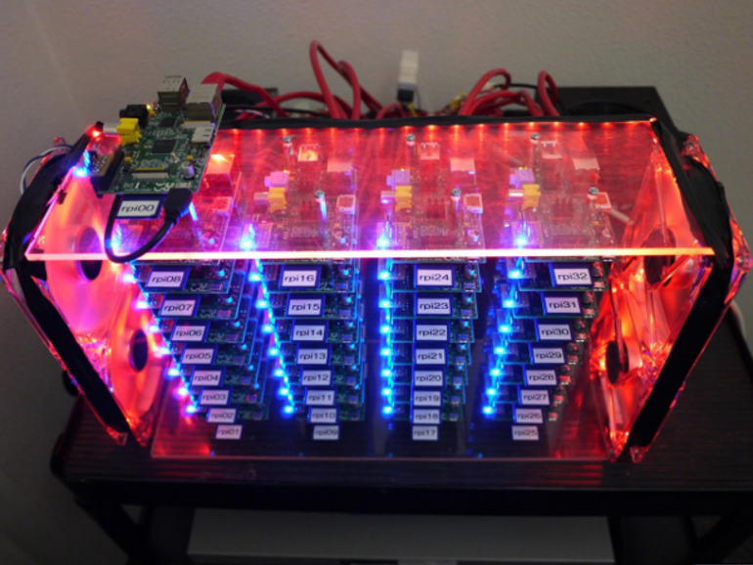
Raspberry Pi Clusters
University projects
Usually 10 to 100 nodes

Slide 7
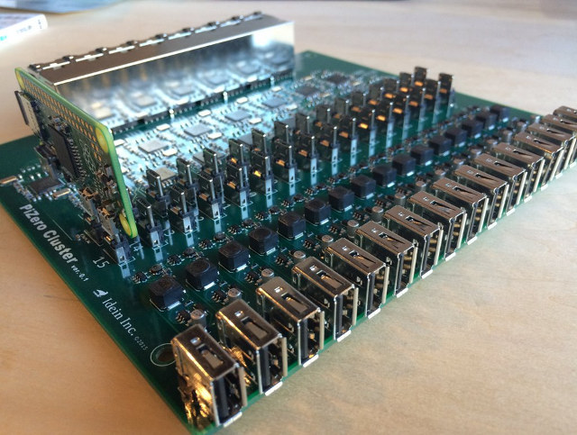
Raspberry Pi Clusters
Specially designed I/O board
Custom designed for Pi-Zeros

Slide 8
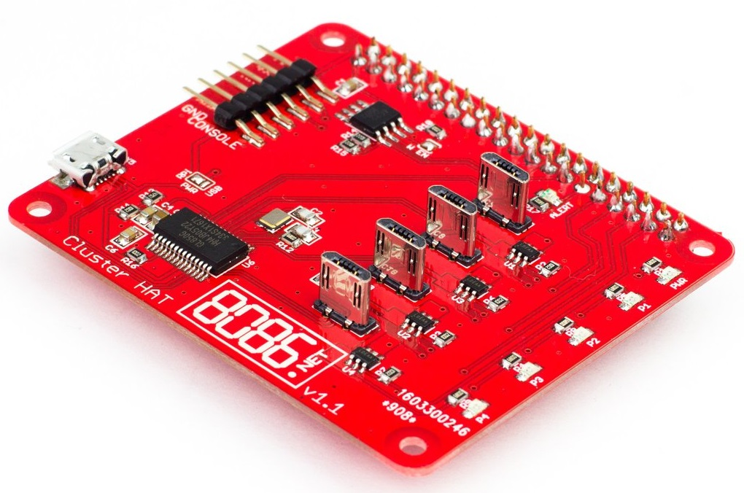
Pi Cluster Hat
Designed and built by 8086 Consultancy
HAT module plugs into Raspberry Pi A+/B+/2/3
Accepts up to 4 Pi Zero boards
Supplies power to each node
Controlled via GPIO pins
Enables network comms
Via USB gadget mode

Slide 9
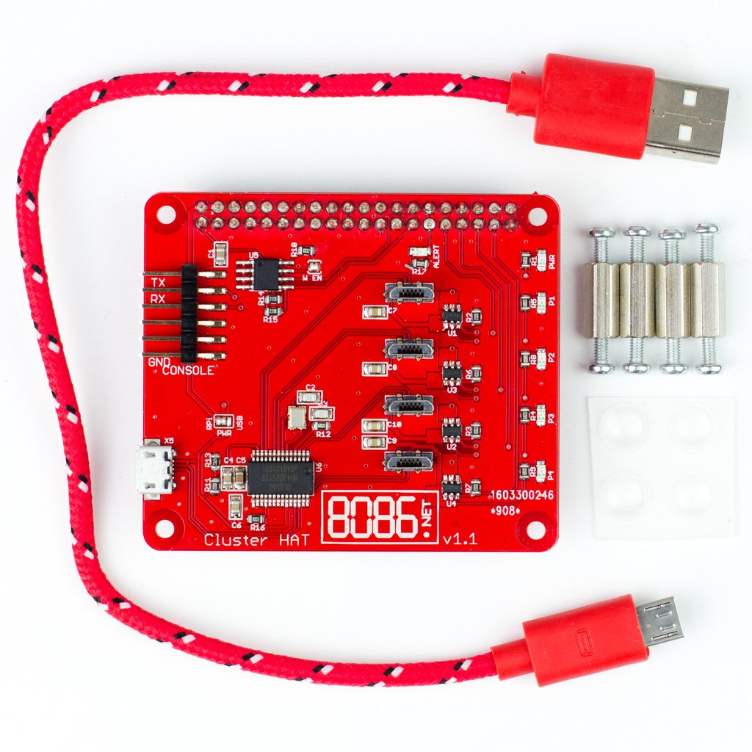
Pi Cluster Hat - Kit
Runs about $35
Kit comes with
Cluster Hat board
USB power cable
Four stand-offs with screws

Slide 10
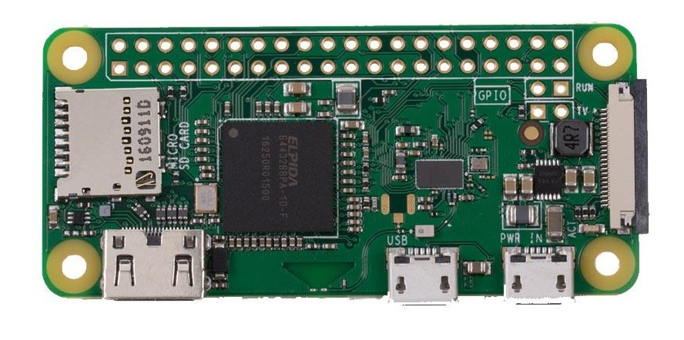
Pi Zero W (an aside)
Only $10
1 Ghz, Single Core
512 MB RAM
Built-in WiFi, BT4.1 and BLE
CSI camera connector
Recommend using 4GB or 8GB SDcard
Micro
SD
Mini
HDMI
USB
OTG

Slide 11
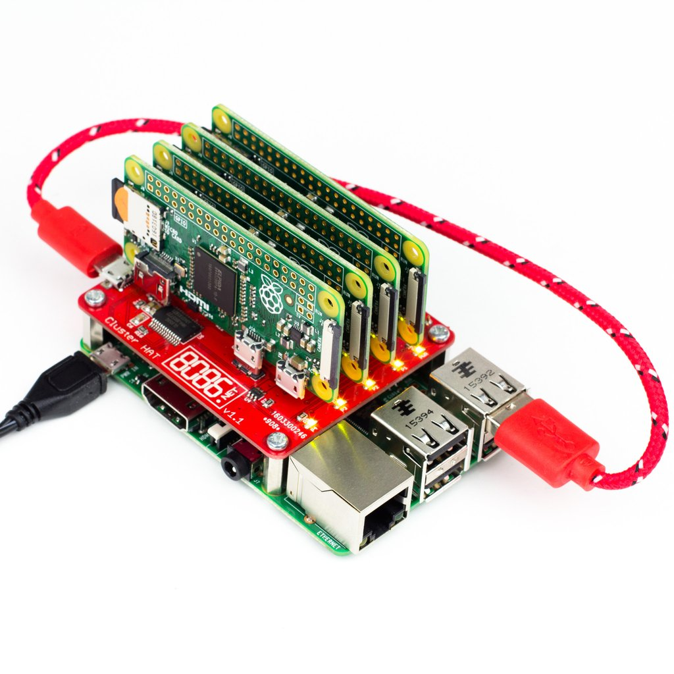
Pi Cluster Hat – Full Setup
Still compact when fully configured
Gets power from Raspberry Pi host
Pi Zeros get comms and power via USB
Recommend using 16GB or 32GB SDcard

Slide 12
Pi Cluster Hat Architecture (ver 1.x)
HDMI
Monitor
Raspberry
Pi 3
(Host)
Power / GPIOs
GPIO22
GPIO23
GPIO24
GPIO25
Pi
Zero
1
Pi
Zero
2
Pi
Zero
3
Pi
Zero
4
Ethernet
LAN
USB4
USB3
USB2
USB1
USB
Keyboard/Mouse
USB Networking

Slide 13


Pi Cluster Hat – Software Setup
See https://clusterhat.com/setup-software
Configure Raspberry Pi host using
PIXEL controller image
Standard Raspbian with extras
Configure each Pi Zero W node using
LITE image (host names set to P1, P2, etc)
No GUI
Setup password-less ssh
Optionally setup WiFi on each Pi Zero W

Slide 14


Pi Cluster Hat – Useful Packages
Distribute
https://github.com/PaulBrownMagic/ClusterHat_Distribute
MPICH
sudo apt-get install mpich
MPI4PY
https://www.hackster.io/darthbison/raspberry-pi-cluster-with-mpi-4602cb
TensorFlow
https://github.com/samjabrahams/tensorflow-on-raspberry-pi

Slide 15
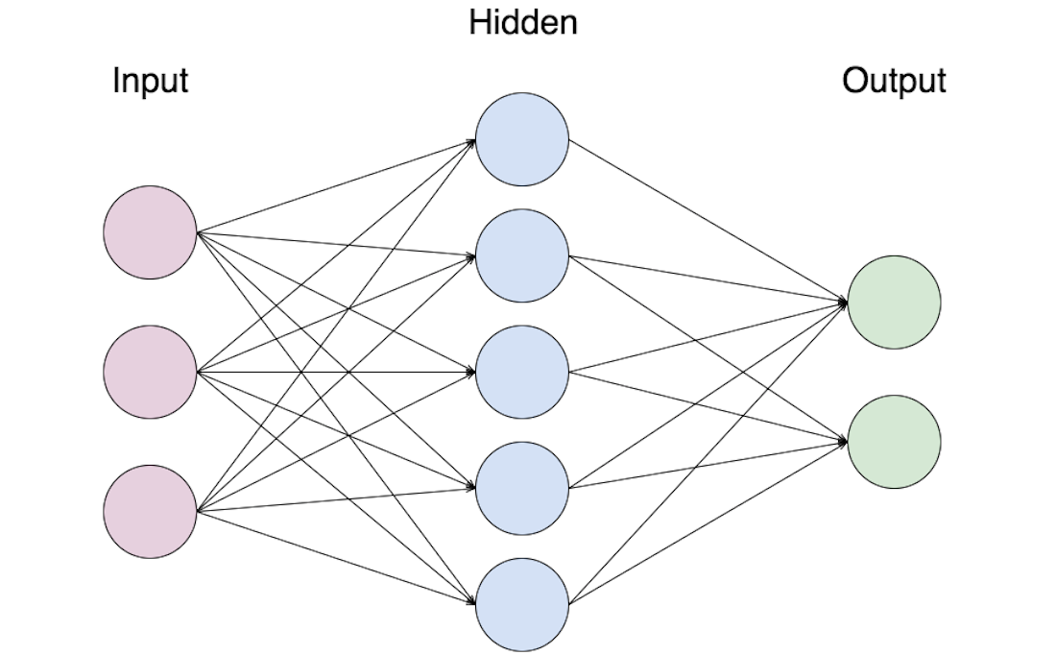
Pi Cluster Hat – What do you do with it?
Learn distributed processing
Learn parallel programming
Using MPI or other library
Simulate neural networks
Using TensorFlow or other library
Machine learning
Using Tensorflow or other library

Slide 16
Demos
Demo of power controls
clusterhat on p1
clusterhat off p3
Demo of networked comms
ssh pi@p1
Demo of distribute
distribute myprog.py
distribute –c “sudo shutdown –h now”
Demo of parallel computing
uptime script
mpi program

Slide 17
Resources
https://clusterhat.com/
https://8086.support/category/23/cluster-hat.html
https://groups.google.com/forum/#!forum/clusterhat

Slide 18
Questions?

